Slide 1

Budget 2025/26
“Your Rates Explained”.

Slide 2


Budget 2025/26– Rates Modelling
No GRV revaluations for 2025/26 as this is undertaken every 5 years, as this occurred last year;
There was, however, an additional 5 minimum rated GRV properties via the interim process in 2024/25;
The Valuer General (Landgate) has completed the Unimproved Value (UV) assessments for all UV properties. UV valuations are $292,488,300. The date of valuation being 01 August 2024. These valuations come into effect on 01 July 2025; and reviewed annually;
This year UV valuations increased in average overall by 20.19% to a valuation of $292,488,300;
Before modelling could be undertaken, the actual rates income levied, interims for 24/25 versus adopted budget amount was applied, to achieve a starting position;
The GRV total levied at billing for 2024/25 was subsequently adjusted to account for the additional properties added from interim valuations throughout 2024/25. The UV total levied was also adjusted in the same manner;
These adjustments are undertaken so not to increase rates purely based on the new GRV & UV valuations;
These adjustments rebalance the rates revenue and creates the baseline (0%) for the “Rate Take” modelling for 25/26; and
The minimums and rates in the dollar have subsequently been modelled for 25/26 for both GRV and UV, by applying an approximate rates levied increase of 7%.

Slide 3
Budget 2025/26 Rates Modelling
Key Points for Consideration
In previous years, the Council has applied the following rates revenue increases:
  2023/24 – 5%
  2024/25 – 5%
For 25/26 the rates revenue increases the minimum and rates in the dollar by approximately 7%;
It should be noted that in this year’s modelling:
  A 1% rate revenue increase equates to approximately $19,200;
  This modelling is based on 380 GRV properties and 357 UV properties, (includes 1 mining tenement);
The average GRV rates amount for 25/26 @ 7% is therefore $763, which includes 182 minimum rated properties.
The total minimum rates property percentile for 2025/26 is 48% and is below the legislated threshold.
The average UV rates amount for 25/26 @ 7% is therefore $4,954, which includes 36 minimum rated properties.

Slide 4
Budget 2025/26 – Rates Modelling
Key Points for Consideration
By modelling the minimums and rates in the dollar by 7%, the % increase in rate take amounts is as follows:
  7% generates a rate take of $2,058,435.
Therefore:
The increase to an average GRV rates bill based on the modelled revenue and rates take is as follows:
  7% = $49 or (13c per day).
The increase to an average UV rates bill based on the modelled revenue and rates take is as follows:
  7% = $388 or (106c per day).

Slide 5
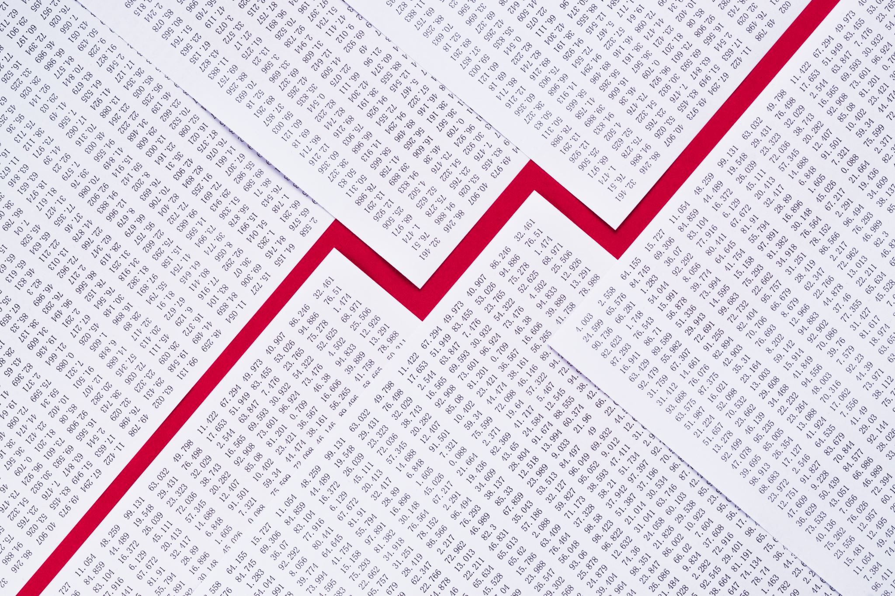
Budget 2025/26 – Rates Modelling
Key Points for Consideration
Therefore, based on the average rates bill, (as discussed previously), the impact for our ratepayers would be as follows:
  Rates revenue modelling of approximately 7% generates an increase to the average GRV ratepayer's bill by $49 per annum ; and
  An increase to the average UV ratepayer bill by $388.

